Slide 1
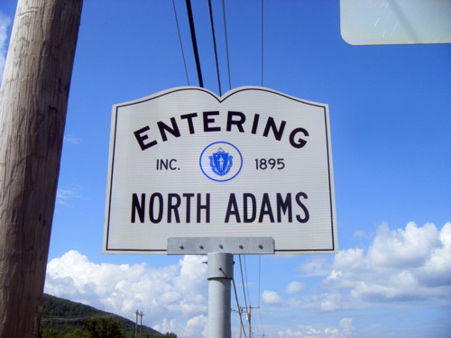
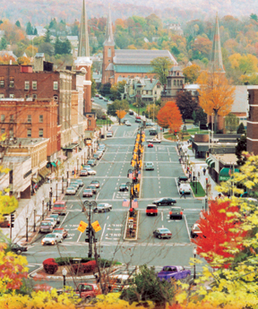
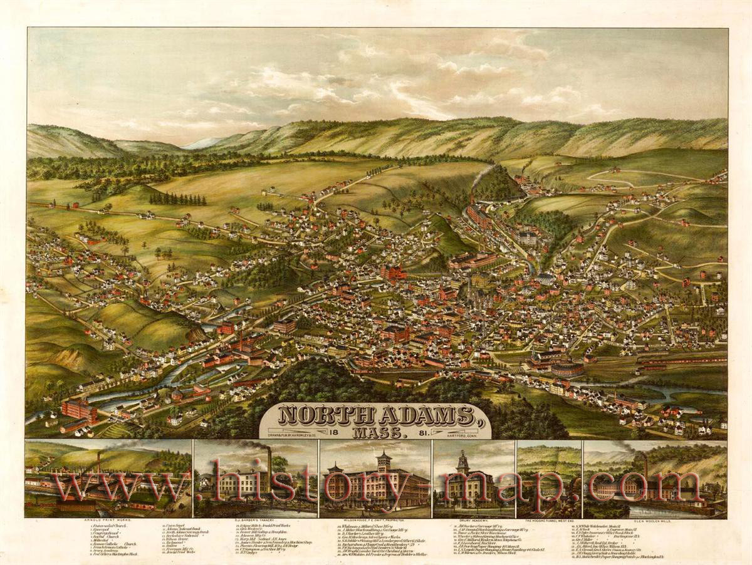
North Adams is the BLANK Canvas and we are the Artists Created By: Emma Waryjasz

Slide 2
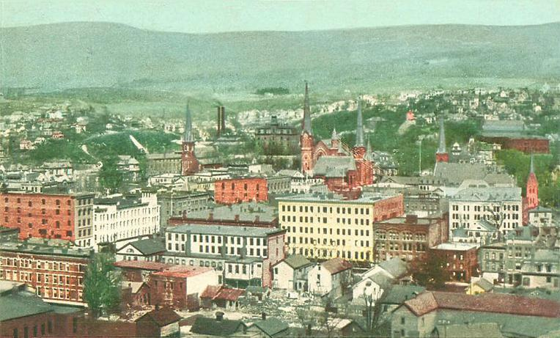
The City of North Adams

Slide 3
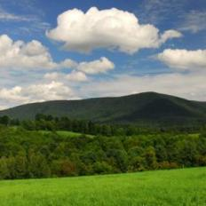
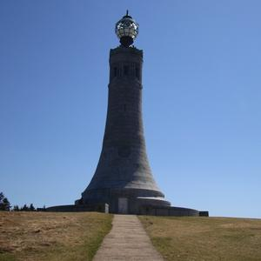
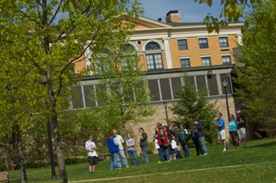
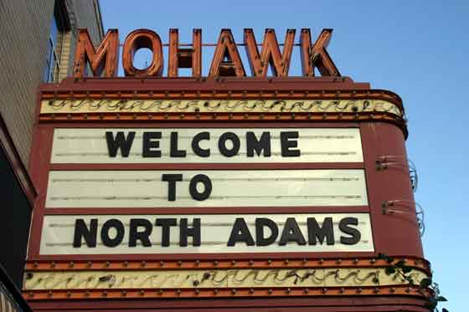
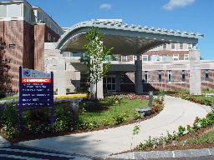
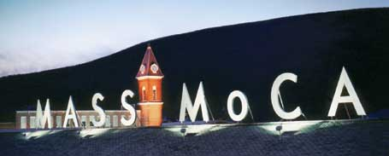
Cultural Aspects

Slide 4
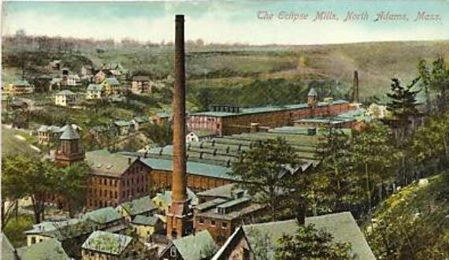
Eclipse Mill

Slide 5
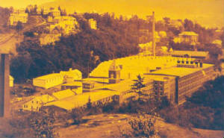
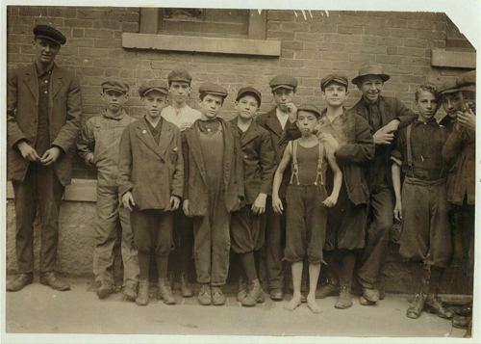
History of the Eclipse Mill
In the early 1860’s the Eclipse Mill was ending its stages of being built
After its construction, the mill was purchased by Arnold Print Works.
Bought out by the Hoosac Mill Corporation in 1911.
Sold to Sprague Electric on May 24, 1957.
A little fewer than twenty years later on New Year’s Day of 1973 Sprague Electric Company was shut down and was bought by Hunter Outdoor Products.

Slide 6
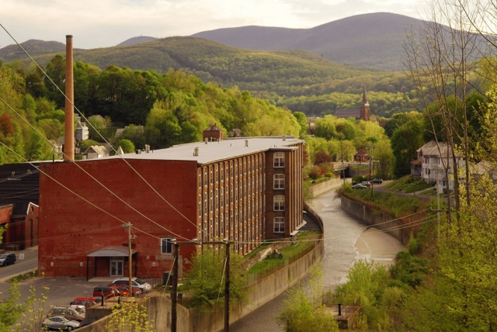
Present Day Eclipse Mill
The mill is now home to many painters, potters, printmakers, musicians, writers, photographers, dancers, and many more creative and unique artists of today. The mill is also home to a few galleries of North Adams.

Slide 7
Future of the Eclipse Mill-Pricy!
I would like to the Eclipse Mill remain as it is; home to many creative and talented artists with their own unique style.
I would also like the Eclipse Mill too be a model to other run down mills and buildings around our city. This mill could show us, the people of North Adams that we can restore these historic buildings into new and beautiful locations for homes, stores, or other types of businesses.

Slide 8
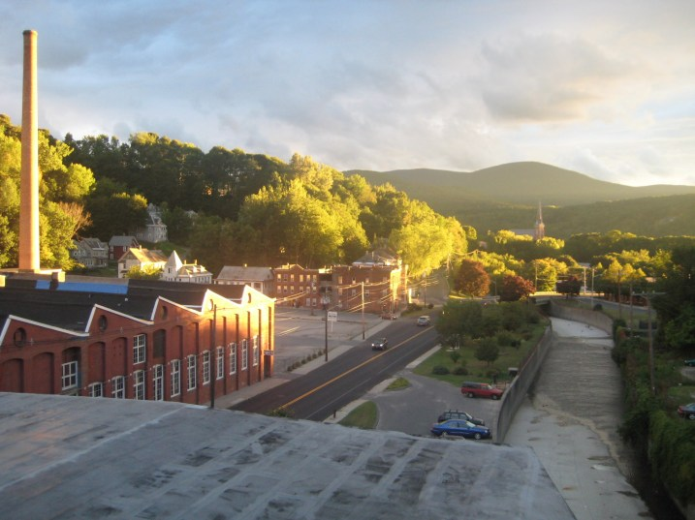
Future’s Horizon-Cheaper!
Another idea I had which would be much more cheaper is ask the artists of the Eclipse Mill to give lessons to the public and residents of the city on creating and expressing art
.

Slide 9
Art is the NEW Future!
Art is the
Future of North Adams

Slide 10
The End
Thank you for your time.

